Slide 1



CHURN MODEL
February 2020

Slide 2
Corporate video

Slide 3
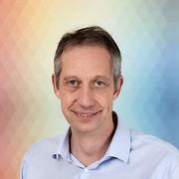
Business Analytics Area
Degree in Mathematics specializing in Operations Research and Statistics, from the Universidad Complutense
Master Degree in Data Science. Juan Carlos I University.
Associate Professor in the Computer Science Department. Carlos III University.
Manuel Gata
manuel.gata@grupo-sm.com
Although my first work steps were in the banking field, I have been in the education sector for more than 20 years. The objective of my area is data analysis, to convert it into information and provide it to the Business Areas, for data based decision making. We are walking the path to become a Data Driven Company.
Hi, I'm Manolo Gata and I work in the Business Analytics area of Ediciones SM. I have a degree in Mathematics, specializing in Operations Research and Statistics, from the Universidad Complutense, a Master's degree in Data Science from the Universidad Juan Carlos I and I have been an associate professor in the Computer Science department of the Universidad Carlos III.

Slide 4
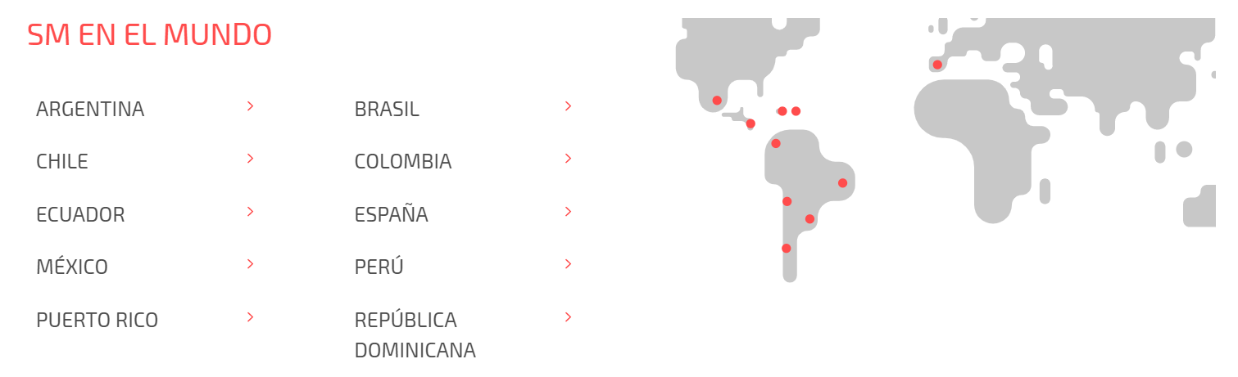
SM is a company focused on the development of integral solutions for education and cultural proposals for children's and young adults' literature. With the benefits obtained, SM Foundation develops educational, research and training projects in vulnerable and less favoured social contexts. We have more than 80 years of experience in the world of education and we are present in several Latin American countries: Argentina, Chile, Ecuador, Mexico, Puerto Rico, Brazil, Colombia, Peru, Dominican Republic and Spain.

Slide 5
Business case
The business case we are going to present you is from Spain.

Slide 6
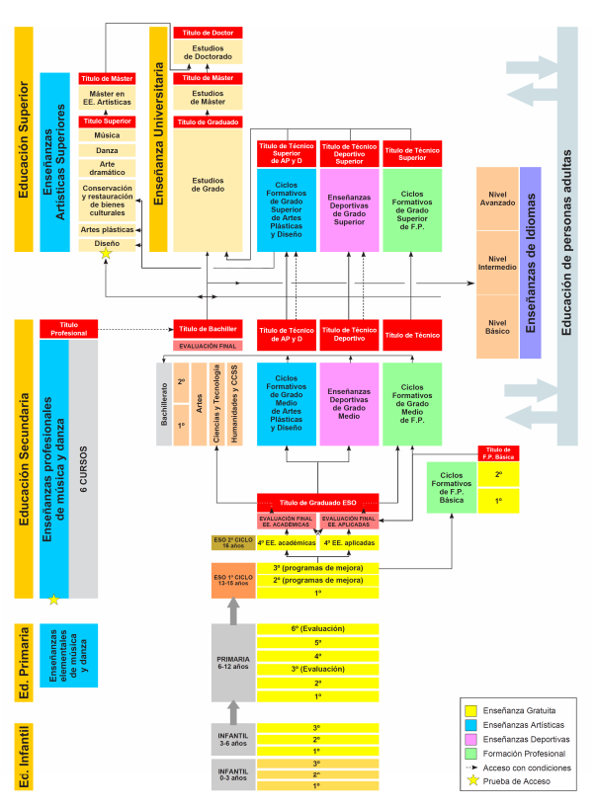
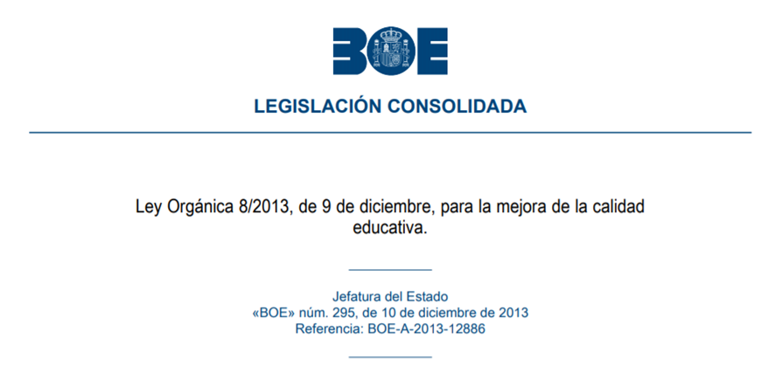
The Spanish education system is currently regulated by the Organic Law for the Improvement of Educational Quality (LOMCE, published in the Official State Gazette on December 9, 2013), where powers are transferred to the Autonomous Communities and it is these Communities that make decisions on how the educational curriculum is taught.
The educational stages in which it is divided are:
Children: from 0 to 5 years old.
Primary: from 6 years to 12 years.
Secondary Education (ESO): from 13 years to 16 years.
Baccalaureate: from 17 to 18 years old.
The courses corresponding to the Primary and Secondary stages are compulsory. These stages are divided into several courses in which different subjects are taught.

Slide 7


Paper
Digital
The publishers produce the educational materials, both on paper and in digital format, for the students.
From the Marketing and Commercial areas we carry out actions to present the materials to the teachers, who are the ones who choose with which publisher they teach their subjects.

Slide 8

In this sector there are many changes of publishers from one school year to another. We manage to attract new clients, but there are many who switch to competing books.

Slide 9
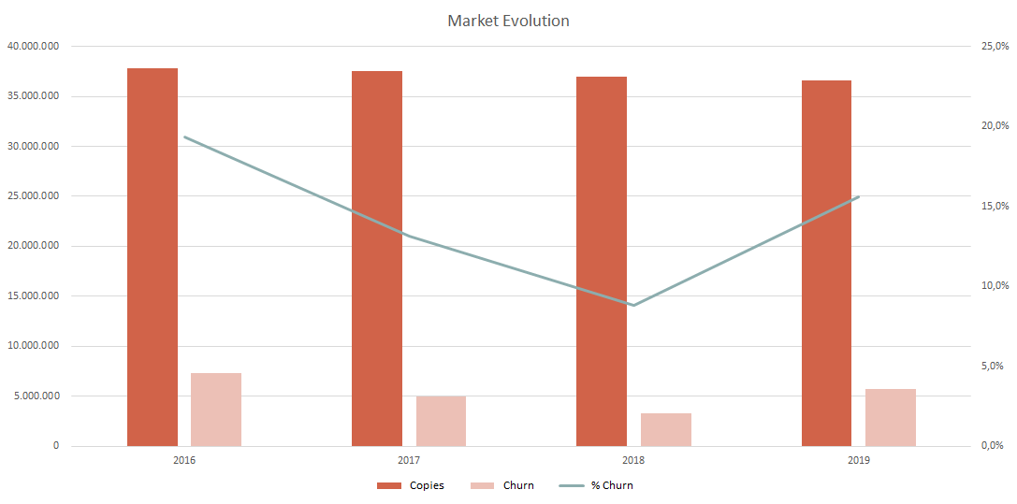
The number of copies passing from one publisher to another has again exceeded 5 million this year. The evolution of the percentage that until last year decreased to below 10%, this year has changed the trend and has been placed above 15%. We're talking about over 5 million copies moving from one publisher to another

Slide 10

DECISSION
JUNE 2019
COMMERCIAL ACTION - 4
MARKETING ACTION - 3
APRIL 2019
COMMERCIAL ACTION - 3
MARKETING ACTION - 2
SEPTEMBER 2018
JANUARY 2019
COMMERCIAL ACTION - 1
MARKETING ACTION - 1
COMMERCIAL ACTION - 2
During the school year we carry out a series of commercial and marketing actions to build customer loyalty. These actions can be aimed at the teacher or the school.
The course is divided into terms, the first term runs from September to January, the second from January to April, and the last from April to June.

Slide 11



The objective that we set from SM is to make a predictive model, to know which will be the teachers that will change to another publishing house.
The model can be made in any platform R, Python, Dataiku, etc using the algorithms you consider most appropriate

Slide 12




In other words, we should propose these two schools because in the first one there are several with a propensity to abandon. The second school we did not propose but the third one we did because there are also quite a few teachers with that propensity to drop out.
The results of the model must be presented to the commercial network in a tool, where they can consult which are the schools where there are more teachers, with a greater propensity to drop out, so that they can plan their visits in an optimal way.
Notes:
In other words, we should propose these two schools because in the first one there are several with a propensity to abandon,
The second school we did not propose but the third one we did because there are also quite a few teachers with that propensity to drop out.

Slide 13
SM Group: https://www.grupo-sm.com/
Corporate Video: https://youtu.be/YVm8EeVKeB8
State Official Gazette (BOE): https://www.boe.es/buscar/pdf/2013/BOE-A-2013-12886-consolidado.pdf
Ministry of Education and Vocational Training: http://www.educacionyfp.gob.es/en/contenidos/estudiantes/portada.html
National Association of Book and Teaching Materials Publishers: https://anele.org/wp-content/uploads/2019/09/190905INF-ANELE-Informe-Libro-Educativo-19-20.pdf
I leave you some links that can be used for consultation.

Slide 14
Thank you !!!
Thank you very much to all of you for helping us in this goal that we set
Notes:
Muchas gracias a todos por ayudarnos en este objetivo que os planteamos

